Slide 1
NEXTHIKES IT SOLUTION PROJECT-2
“ Data harmonization and insights extraction”
by:- naman sharma.

Slide 2
INTRODUCTION
This project is all about to leverage advanced data- wrangling techniques to produce a clean, unified dataset for future business analysis and modeling.
The main aim of this project is to preprocess, visualize and to merge dataset to generate the useful insights.

Slide 3
WORK FLOW
Pre-process dataset-1.
Visualize dataset-1.
Pre-process dataset-2.
Visualize dataset-2.
Merge both dataset-1 and dataset-2.
Pre-process and Visualize the merged dataset.
Pre-process dataset-3.
Visualize dataset-3.
Concat dataset-3 and merged dataset.
Final pre-processing and visualization of data.

Slide 4
Dataset-1,Dataset-2,Dataset-3 Preprocessing
KEY POINTS :-
Perform the Exploratory Data Analysis(EDA).
Functions used:- head, tail, drop, info, duplicated, describe.
Filled the missing values by using fillna function.
Library used :-
Pandas.
Numpy.
Seaborn.
Matplotlib.

Slide 5
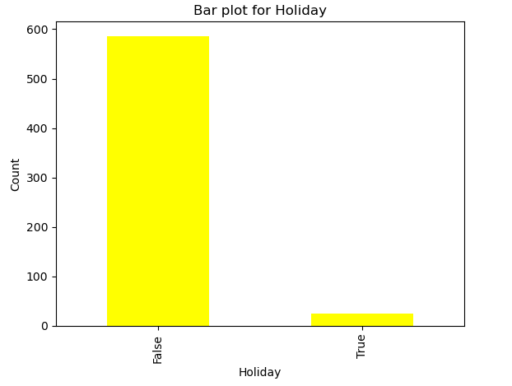
DATASET -1 VISUALIZATION
Here false=0 i.e number of holidays not taken.
true=1 i.e number of holidays taken.

Slide 6
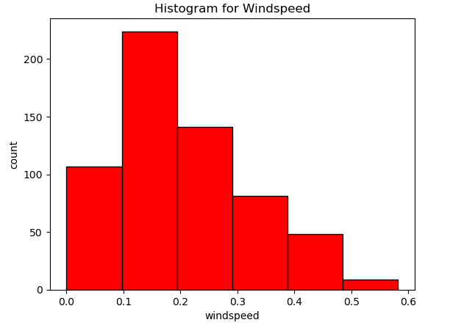
DATASET-2 VISUALIZATION
It tells the variation in the "wind speed" as the day passes.

Slide 7
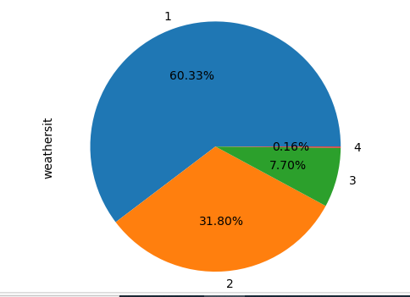
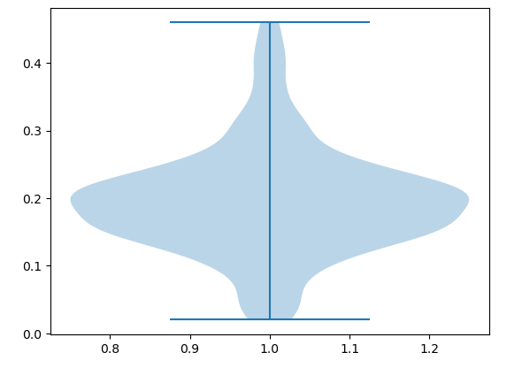
MERGED DATASET VISUALIZATIONS
By looking at the violin plot we can say that there are no outliers in temp column.
# The width of the "violin" shows the density, so the wider region indicates more data points in that range.
Showing the distribution of weather situation
Percentage wise.

Slide 8
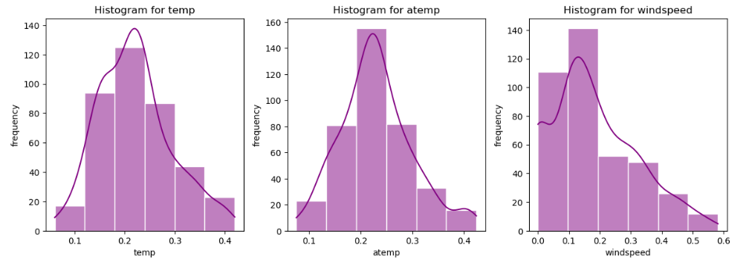
Dataset-3 Visualizations
The histogram shows the pattern and shape of the data i.e how data is distributed.
# For the column “temp" it shows that the data is symmetrical i.e bell shaped.
# For the column “windspeed" it shows that the data is positively skewed.

Slide 9
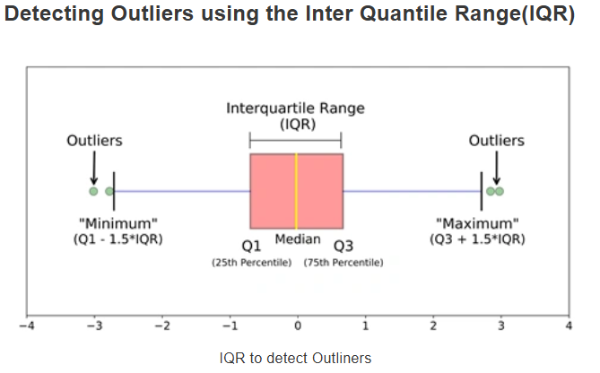
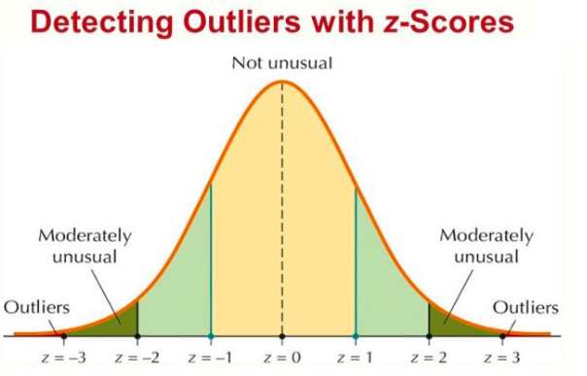
Methods for Outlier Detection
Below are some of the techniques of detecting outliers :-
Boxplots
Z-score
Inter Quantile Range(IQR)

Slide 10
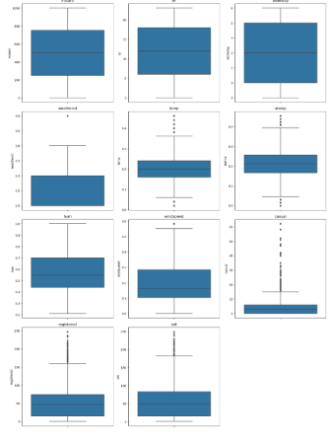
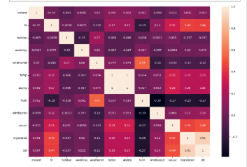
Final Dataset Visualizations
The heat map reveals the correlations between variables.
Showing strong relationships between temperature and atemp.
While the other columns have a medium correlation between them.
humidity and weathersit shows 0.54.
casual and cnt shows 0.56.
instant and holiday shows negation correlation.
# temp and weekday shows negative correlation.
The boxplot shows the outliers in the data.
.

Slide 11
DIFFERENT TYPES OF VISUALIZATION USED FOR INSIGHTS EXTRACTION
Bar chart.
Pie chart.
Line plot.
Histogram.
Violin plot.
Scatter plot.
Heat map.
Boxplot.

Slide 12
LEARNING OUTCOMES :-
• Gain practical experience in dataset cleaning and wrangling.
• Develop an understanding of exploratory data analysis techniques.
• Prepare datasets for advanced modeling and business use cases.

Slide 13
Reference:
1.https://www.analyticsvidhya.com/blog/2021/05/detecting-and-treating-outliers-treating-the-odd-one-out/
2.https://www.geeksforgeeks.org/
3.https://www.w3schools.com/

Slide 14
THANK YOU

